Slide 1


K-means, FCM
Ha-Rang Kim
25.7.06
ⓒSaebyeol Yu. Saebyeol’s PowerPoint

Slide 2
Table of contents
1
K-means
2
FCM

Slide 3
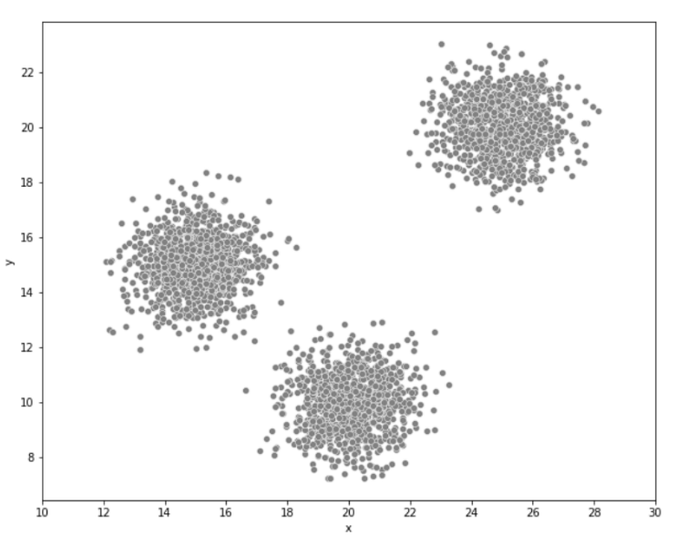
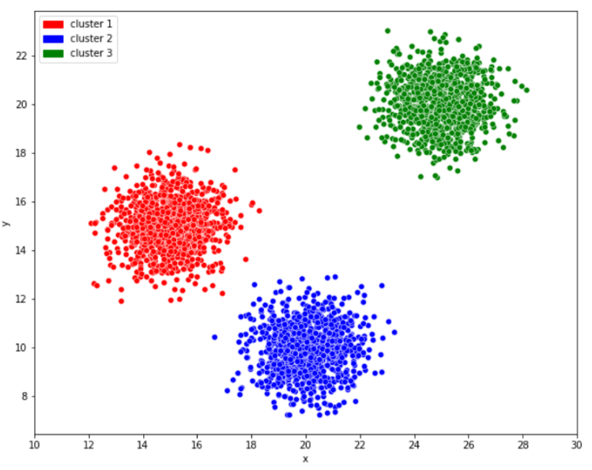

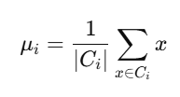
K-means
Unsupervised learning

Slide 4
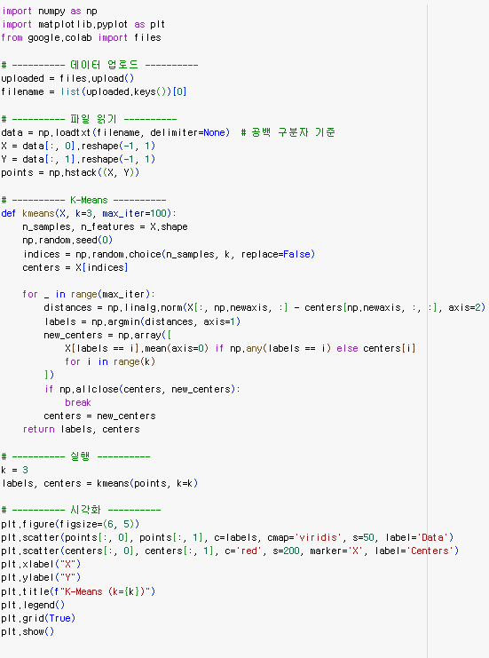
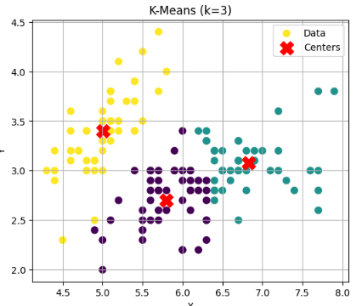
K-means

Slide 5
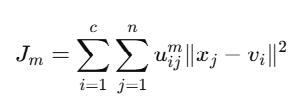


FCM

Slide 6

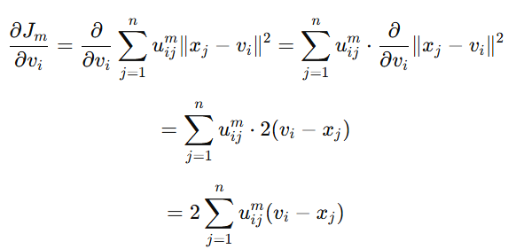
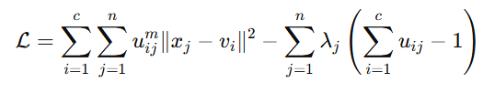
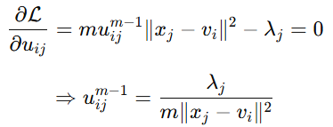
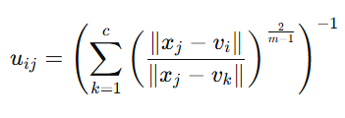


FCM

Slide 7
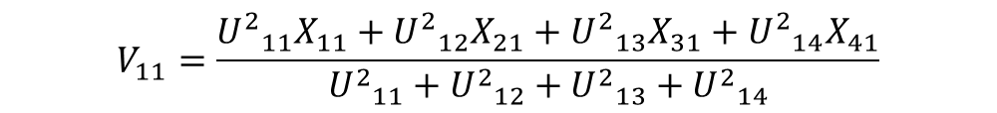



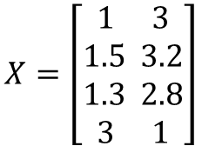

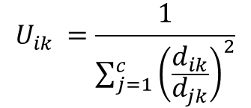



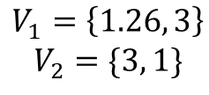
FCM
$$X=\left[\begin{aligned}1 3 \\ 1.5 3.2 \\ 1.3 2.8 \\ 3 1\end{aligned}\right]$$
$$3.U_{ik }$$
$$U_{ik }=\frac{1}{\sum_{j=1}^{c}{{\left(\frac{d_{ik}}{d_{jk}}\right)}^{2}}}$$
1. U=$\left[\begin{aligned}1 1 1 0 \\ 0 0 0 1\end{aligned}\right]$
$$U_{ }=\left[\begin{aligned}0.991 0.986 0.993 0 \\ 0.009 0.014 0.007 1\end{aligned}\right]$$
$d_{ik}$ $d_{jk}$
$$2.V_{ij}$$
$$V_{11}=\frac{{U^{2}}_{11}X_{11}+{U^{2}}_{12}X_{21}+{U^{2}}_{13}X_{31}+{U^{2}}_{14}X_{41}}{{U^{2}}_{11}+{U^{2}}_{12}+{U^{2}}_{13}+{U^{2}}_{14}}$$
$V_{11}=\frac{1\left(1\right)+\left(1\right)1.5+\left(1\right)1.3+\left(0\right)3}{1+1+1+0}$= $\frac{3.8}{3}=1.26$
$$V_{12}=\frac{{U^{2}}_{11}X_{12}+{U^{2}}_{12}X_{22}+{U^{2}}_{13}X_{32}+{U^{2}}_{14}X_{42}}{{U^{2}}_{11}+{U^{2}}_{12}+{U^{2}}_{13}+{U^{2}}_{14}}$$
$$V_{1}=\left\{1.26, 3\right\}$$
$$V_{2}=\{3, 1\}$$
$V_{12}=\frac{1\left(3\right)+\left(1\right)3.2+\left(1\right)2.8+\left(0\right)1}{1+1+1+0}$= $\frac{9}{3}=3$

Slide 8
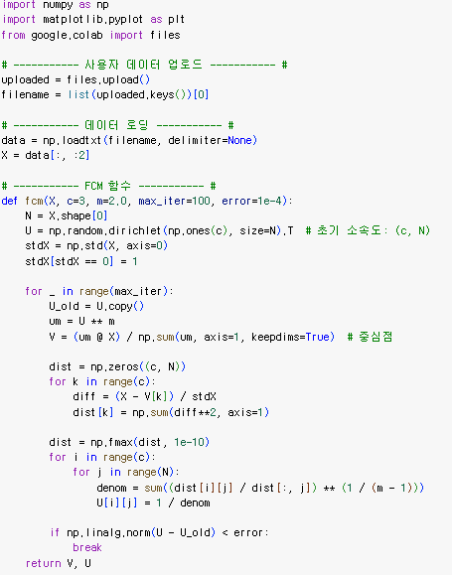
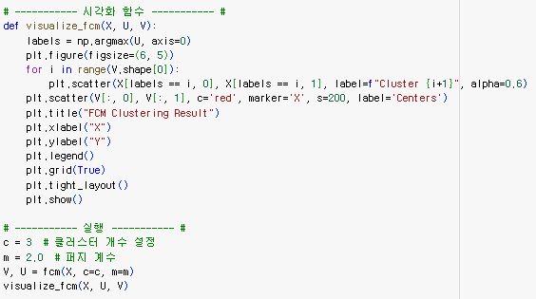
FCM

Slide 9
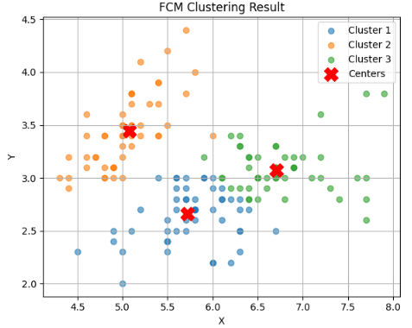
FCM

